Slide 1
Navigating the Label Regulatory Requirements for Soil Fumigation
Maine Board of Pesticides Control
90 Blossom Lane
AMHI Campus, Deering Building
Augusta, Maine 04333-0028
(207)287-2731
Keith Brown
District 5 Pesticide Inspector
keith.r.brown@maine.gov
(207)592-0416
Notes:
I am relatively new as a pesticide inspector. The first 20 years of my career were spent as part of the heavy/highway/utility/commercial building construction industry, and the last 20 years were spent as a consultant that sometimes involved litigation support. Although I have only recently obtained my commercial operator license with the soil fumigation commodity, As a contractor, I, like many of you have experienced the visit by a government inspector (Federal OSHA) and as a consultant I have had opportunity to witness the time that can be expended when one party has a complaint against another. It is from these experiences that I have premised the following presentation,. I will attempt to provide insight that will help an applicator feel comfortable demonstrating his or her compliance with label requirements either to an inspector or others, and also to help applicators reduce risk management relative to his or her self, coworkers and the public at large.

Slide 2
Or “Putting the Parts Together”
Navigating the Label Regulatory Requirements for Soil Fumigation
Notes:
You will see in the following slides that label compliance for soil fumigation, although more involved than granular or spray applications can be broken down into smaller parts that can be more easily managed if you plan ahead and work on one segment at a time to create a plan that can be used year to year instead of for each and every application.

Slide 3
Background Information
Soil Fumigation:
An effective deterrent to certain soil-born pests.
The product is applied directly to the medium where the target pests are located.
Does not need to pass through air or crop plant systems to reach the target.
The process is a relatively new application method to the Maine Potato Industry, but is common practice in many other states
Notes:
The soil fumigation manual lists wireworms, nematodes, fungi and some bacteria as some targets for soil fumigation techniques.
Some states that utilize soil fumigation extensively include: Idaho, California, Washington, Florida, Georgia, North Carolina, Minnesota, Michigan and Wisconsin.
Although the record keeping and documentation process is somewhat more involved than that for more typical spray applications, growers across the country have been following these procedures for many years.

Slide 4
Objective of this Presentation:
Illustrate the regulatory requirements associated with soil fumigation in sufficient detail to help you:
See the compliance process as a series of individual steps that can be completed in a systematic manner
Utilize the regulatory requirements as an effective tool to:
accurately document your fumigation applications,
reduce risk of exposure to complaints
reduce duplication of paperwork.
Notes:
Proper documentation will help to assure that the Maine Agricultural Community will be able to continue use of the soil fumigation technique in a manner similar to its competit
ors in other states.

Slide 5
Why all the fuss ?
Fumigants are among the most hazardous of all pesticides with signal words like Danger-Poison, Danger or Warning
Chemical properties that make fumigants so effective in managing difficult to control soil pests are the same properties that can be hazardous to applicators, handlers and nearby persons not associated with the application.
Even under optimum application conditions, by their nature, fumigants have greater potential for off-target drift that could adversely impact persons than more conventionally applied spray applications under similar conditions.
Notes:
Because active fumigants are vapors and not liquids, they have greater potential to drift than spray applications under similar conditions

Slide 6
Just as you can’t drive the car if you can’t reach the pedals, you can’t fumigate the soil if you don’t have a plan

Slide 7
What’s in it for me (the applicator) ?
No fines !-The label is the law, failure to comply will result in fines or other disciplinary action.
Improved productivity-Industry has proven that detailed pre-project planning including provisions for accident prevention and emergency situations results in measurable improvements to the bottom line.
Well documented records can be referred to when planning future applications or evaluating the effectiveness of past applications.
Well documented records are a grower’s first line of defense when a formal complaint arises.
Notes:
Examples are Cianbro and Huber Engineered Woods.

Slide 8
Recent BPC soil fumigation inspections
Have shown that individual applicators are doing a pretty good job with Fumigation Management plans, but overall, there is some room for improvement, including:
Better documentation of applicator certification and handler training
Upgrade of application block diagrams
Better descriptions of emergency procedures

Slide 9
So let’s get started with the 5-step process
Documentation of the Target Pests
Certification of Personnel
Fumigation Management Plans
Pesticide Application Logs
Post Application Summaries

Slide 10
Step1: What pest is your target ?
Several of the fumigation inspections I recently completed did not list a target pest on the fumigation management plan.
A common question presented to me when discussing soil fumigation with persons not directly involved with applications is ”What are the applicators actually treating for?”
More conventional spray applications have readily visible and tangible targets such as insects or blight. Soil fumigation targets are not as readily visible.
Notes:
Blight conditions can be predicted, insect pests can be seen. Because soil fumigation related targets and short term results are not as readily visible to the naked eye, it can appear to be more of a mystery treatment than other pesticide application techniques.
To this end, it is important to select fumigants that have been determined to be most effective against the target pests.
“Increased yield”, while an ultimate goal, is not sufficient reason to justify soil fumigation as far as label requirements are concerned.
The industry needs to better establish pre-and post-application data to justify application of soil fumigants. At some point, absence of target data could result in increased regulation of the process.

Slide 11
Soil Fumigant Targets are not visible from the outside. You can see insects, you can predict blight. Fumigant targets require a more in-depth approach to documentation.

Slide 12
Step 2: Obtain Certification and Provide Handler Training
Who are the players ?
Certified Applicator
Certified Applicator in Charge
Fumigant Handler
WPS Handler

Slide 13
Certified Applicator
Must hold either a private or commercial applicator license
Must complete a soil fumigant training program
http://www.epa.gov/fumiganttraining
Be careful ! There is only one source that provides EPA recognized certification, and that can be found at the above site.
Certification must be renewed every three years
Certificates are dated and numbered
Training by any other source is likely not valid unless presenter has coordinated training with EPA’s course administrator.
Fumigant training is active ingredient specific, i.e., training for Metam products does not qualify one for Chloropicirin products and vice versa
State of Maine Category does not count as EPA training.
Notes:
EPA certified applicator certificates must be renewed every 3 years.

Slide 14
Be sure your certificate looks similar to this.

Slide 15
State of Maine Certification Requirements
Commercial applicators must hold Category 1B-III, Soil Fumigation
Private applicators must have private category-Soil Fumigation (as of January 1, 2020)
Note that there is no “Grandfathering” provision. Private applicators who in the past operated as “Certified Applicator in Charge” will also need to qualify for the soil fumigation category by taking and passing the exam.
Notes:
This is the same manual as is used for the EPA training.

Slide 16
Certified Applicator in Charge
Pesticide labels require that a “Certified Applicator in Charge” provide on-site supervision during a fumigant application.
Certified Applicator in Charge must sign and will be fully responsible for the information contained in a fumigation management plan and a post application summary
Note the difference between on-site supervision and direct supervision.
On-site supervision means that the certified applicator in charge must remain on-site during the fumigant application process.
Direct supervision, as it relates to spray applications, allows a supervisor to be off site during a spray application, provided proper communication channels exist between the supervisor and the operator.
Notes:
On-site supervision is required for soil fumigant applications; direct supervision is allowed for spray applications.

Slide 17
Fumigant Handlers
Certified applicator in charge must provide “Fumigant Safe Handling Information” to all persons who:
Participate in the application
Monitor fumigant air concentrations
Clean-up fumigant spills
Handle or dispose of fumigant containers
Clean, adjust or repair equipment
Enter the application block from the start of application to the end of the buffer zone period
Perform any handler task as defined by the Worker Protection Standard
Information available from http://www.epa.gov/fumiganttraining or possibly from the fumigant supplier.
Annual training required
Must be documented by the certified applicator in charge
Fumigant safe handler training is in addition to WPS handler training.
Notes:
This also means farm mechanics who work on the equipment
Training includes:
What fumigants are and how they work
Safe application and handling
Air monitoring and respiratory protection
Early signs of symptoms of exposure
Emergency response
Reporting incidents.

Slide 18
Fumigant Handler Training should also include farm mechanics who work on the equipment
Training includes:
What fumigants are and how they work
Safe application and handling
Air monitoring and respiratory protection
Early signs of symptoms of exposure
Emergency response
Reporting incidents.

Slide 19
Speaking of WPS
All fumigant labels require the use of a respirator under certain circumstances.
Documentation required for all certified applicators and fumigant handlers:
Proof of preliminary screening
Proof of physical exam (if necessitated by the preliminary screening)
Proof of annual fit test
Get a note or a card from the medical professional-don’t include the actual screening papers or the exam papers (nobody really wants to know your age or how much you weigh).
Be sure there is an adequate quantity of functional respirators on-site. Required quantities vary by product label.

Slide 20
Always wear your PPE

Slide 21
Step 3: Develop Your Fumigation Management Plan
Why ?
Fumigation Management Plans prevent accidents.
Fumigation Management Plans ensure, demonstrate and verify intent to make application in accordance with the label.
Fumigation Management Plans define procedures to follow in the event of an accident or the occurrence of unforeseen events or circumstances.
To date, most Fumigation Management Plans observed by BPC have been site specific and also application specific.
Notes:
In today’s world of instant gratification and social media, Perception is now often taken as truth regardless of facts at hand. Use of pesticides is increasingly coming under scrutiny by persons who are not as well versed on the subject as those who handle the products. I use growing concern of forestry aerial applications as an example. A single incident involving off gassing of a soil fumigant could possibly create enough negative public perception to result in a significant black eye to the entire industry state-wide.

Slide 22
SUGGESTION: Consider developing an overall general farm fumigation management plan
A General Fumigation Management Plan can capture information common to the entire farm operation in one package.
Will reduce duplication of efforts and ultimately save time.
Can be updated down the road for subsequent applications.
Individual application blocks can be addressed with application-specific details as addenda to the general plan.
Make the general plan a computer-based permanent document with hard copies bound in a loose leaf binder for use in the field and for inspection.
Notes:
My logic for this suggestion will become more evident in the following slides.

Slide 23
Comments based on what I have seen so far
The following slides will be based on a Chloropicrin-specific Fumigation Management Plan template taken from the EPA website.
However, other active ingredient specific templates are similar in nature and this part of the discussion applies to all products.
Notes:
Application-specific templates are available at the EPA fumigation website.

Slide 24
Section 1- Certified Applicator Information
Include your “proof of training” certificate number along with your Pesticide Applicator license number in the box that calls for “license and/or certificate number”
Be more specific regarding “date and location of completing EPA approved certified applicator training.
Providing sufficient information here negates the need to include a copy of your training certificate in the Fumigation Management Plan.
Example:
PPA-XXXX
SFAT#XXXXXXX
Example: On-line, at office, September 19, 2019

Slide 25
Section 2-General Site Information
Application block location- Be specific enough such that an EPA official sitting in Boston could locate the application block on Google Earth or similar software package, or physically locate the site using a GPS.
Consider using Google Earth or similar software to develop the site map (You do not know who will eventually view the site map, and under what circumstances). Remember that a picture is worth a thousand words, and a clear picture will reduce subjectivity as to what your plans included.
Be sure to include :
Block dimensions or a graphic scale
Buffer zone dimensions (buffer zone width, for sure)
Property lines (if block bounds upon another owner)
You do not need a survey in most cases-just indicate that you are aware of your neighbor’s property, and illustrate that you have taken this into consideration in the preparation of the plan.
Rights-of-way
This should include ATV trails
Buffer zone and application block sign locations
There are local farm service agencies that should be able to assist with the map generation process. Once prepared, map can be easily updated for subsequent applications.
Notes:
Central Aroostook Soil and Water Conservation District will provide this service free of charge.

Slide 26
An “Overall” Farm Block Map
A “site-specific” diagram can readily be developed from the “overall” block map.

Slide 27
Site Specific Site Plan used in conjunction with an overall Site Plan
There are resources that can be utilized for free assistance generating site plans.

Slide 28
Some sections are self explanatory
Section III-Application Block Owner Information
Incude the name of the property owner as well as the tenant if application block is leased
Section IV-Record Keeping
This is a check box
Section V-General Application Information
Injection depty, application rate, etc

Slide 29
Section VI- Buffer Zones
Be specific if claiming a buffer zone credit. Provide enough information that a person reviewing the plan can replicate your determination of the credit

Slide 30
Section VII-Emergency Response Plan
Example: “From Northwest field entrance/staging area onto XYZ road, north to farm shop”, or
This can be included on the site map.
Contact information:
Fire Department: 911 (or local number)
Ambulance: 911 (or local number)
Police Dept: 911 (or local number)
Local/Federal/State officials:
Me Dept. of Environmental Protection: (888)769-1053
Maine Board of Pesticides Control: (207) 287-2731
District 5 Pesticide Inspector: (207)592-0416
Include an emergency procedure for each of the applicable situations stated in this block.
Sensory irritation outside buffer zone
Mechanical or seal failure
Complaint

Slide 31
Section VIII-Communication between Applicator, Owner and Other On-site
No Brainer
Chances are, this will be a “no”.
Remember, a handler will likely be present from time to time, monitoring air or maintaining or removing signs, etc.
If you anticipate no one will be on the block during the restricted entry period, state that here.
This section clearly shows a person reviewing your plan that the plan has been created as a well-though-out process.

Slide 32
Section IX-Handler Information (pretty much-self explanatory)
If your general plan lists more employees than what will be actually working on this application, list the specific employee names here for a specific application.
Section X-Tarp Plan (also self-explanatory)

Slide 33
Section XI-Soil Conditions
Don’t forget to fill in all applicable blanks and boxes.
Make sure your “description of soil” matches verbiage found in the USDA method.
Section XII-Posting Signs-Fumigant Treated Area and Buffer Zones
Self Explanatory
This can be shown on the site map.
Example:
Silt clay loam
Weak ball
No water stains
25-50%
See Site Map.

Slide 34
Free Download
https://www.nrcs.usda.gov/Internet/FSE_DOCUMENTS/nrcs144p2_051845.pdf
Just go to google and type in “USDA Estimating Soil Moisture by Feel and Appearance”
Only 6 pages to print.

Slide 35
Section XIII- Emergency Preparedness and Response Measures
Details will be important here
Your best risk management defense to reduce the possibility of a complaint.
Keep your original copy of conversation notes used to fill in this area elsewhere. Write it down, don’t depend on memory. Date, time, who you spoke with.
Section XIV-State and/or Tribal Land Agency Advance Notice
Know who your abutters are.
Don’t forget to check if not applicable.
This will likely either be the certified applicator in charge or the property owner.
In person, mail, phone, etc.

Slide 36
Section XV- Air Monitoring Plan
Most, if not all of this can be completed once if you are creating a general plan.
EXAMPLE:
Drager Pump: p/n 640000
Drager Tubes: Chloropicrin 0.1/a
p/n 8103421
Notes:
This can be part of the general fumigation management plan. Do not just write “air pump” Remember-details are evidence of good project planning. Load it into the general plan as soon as you receive the monitoring equipment and you won’t have to fill this out for every application.

Slide 37
Section XVI- Good Agricultural Practices (GAPS)
Pretty much self-explanatory, good opportunity to create a general plan here.
How was application depth determined ?
How do you prevent end row spillage ?
Etc.

Slide 38
Handler Information Sheet
There should be a separate sheet for each handler.
Again, this could be completed for a general plan and updated annually.

Slide 39
Step 4-Keep a record of the fumigation application in your Pesticide Applicator Log Book
All pesticide applications must be recorded in the Log Book.
This is a requirement independent of fumigation-specific regulations.

Slide 40
Sprayer Calibration Log
“Sprayer” in this instance is intended to mean “application rig”.
Fill out applicable blanks, with “n/a” in those not applicable.

Slide 41
Pesticide Key
Notes:
Don’t forget to include all applications, including pre-plant seed treatments.

Slide 42
Applicator Log
This shows more specific climate information for the date/time of application, as opposed to the more general information in the Fumigation Management Plan.
Items that are more specific include:
Actual Application Date
Start time
Finish time
Wind (Speed & Direction)
Temperature
Cloud cover
Notes:
Commercial applicators can include this information to clients on invoices/statements as is standard practice for landscape companies, do not have to copy logs.

Slide 43
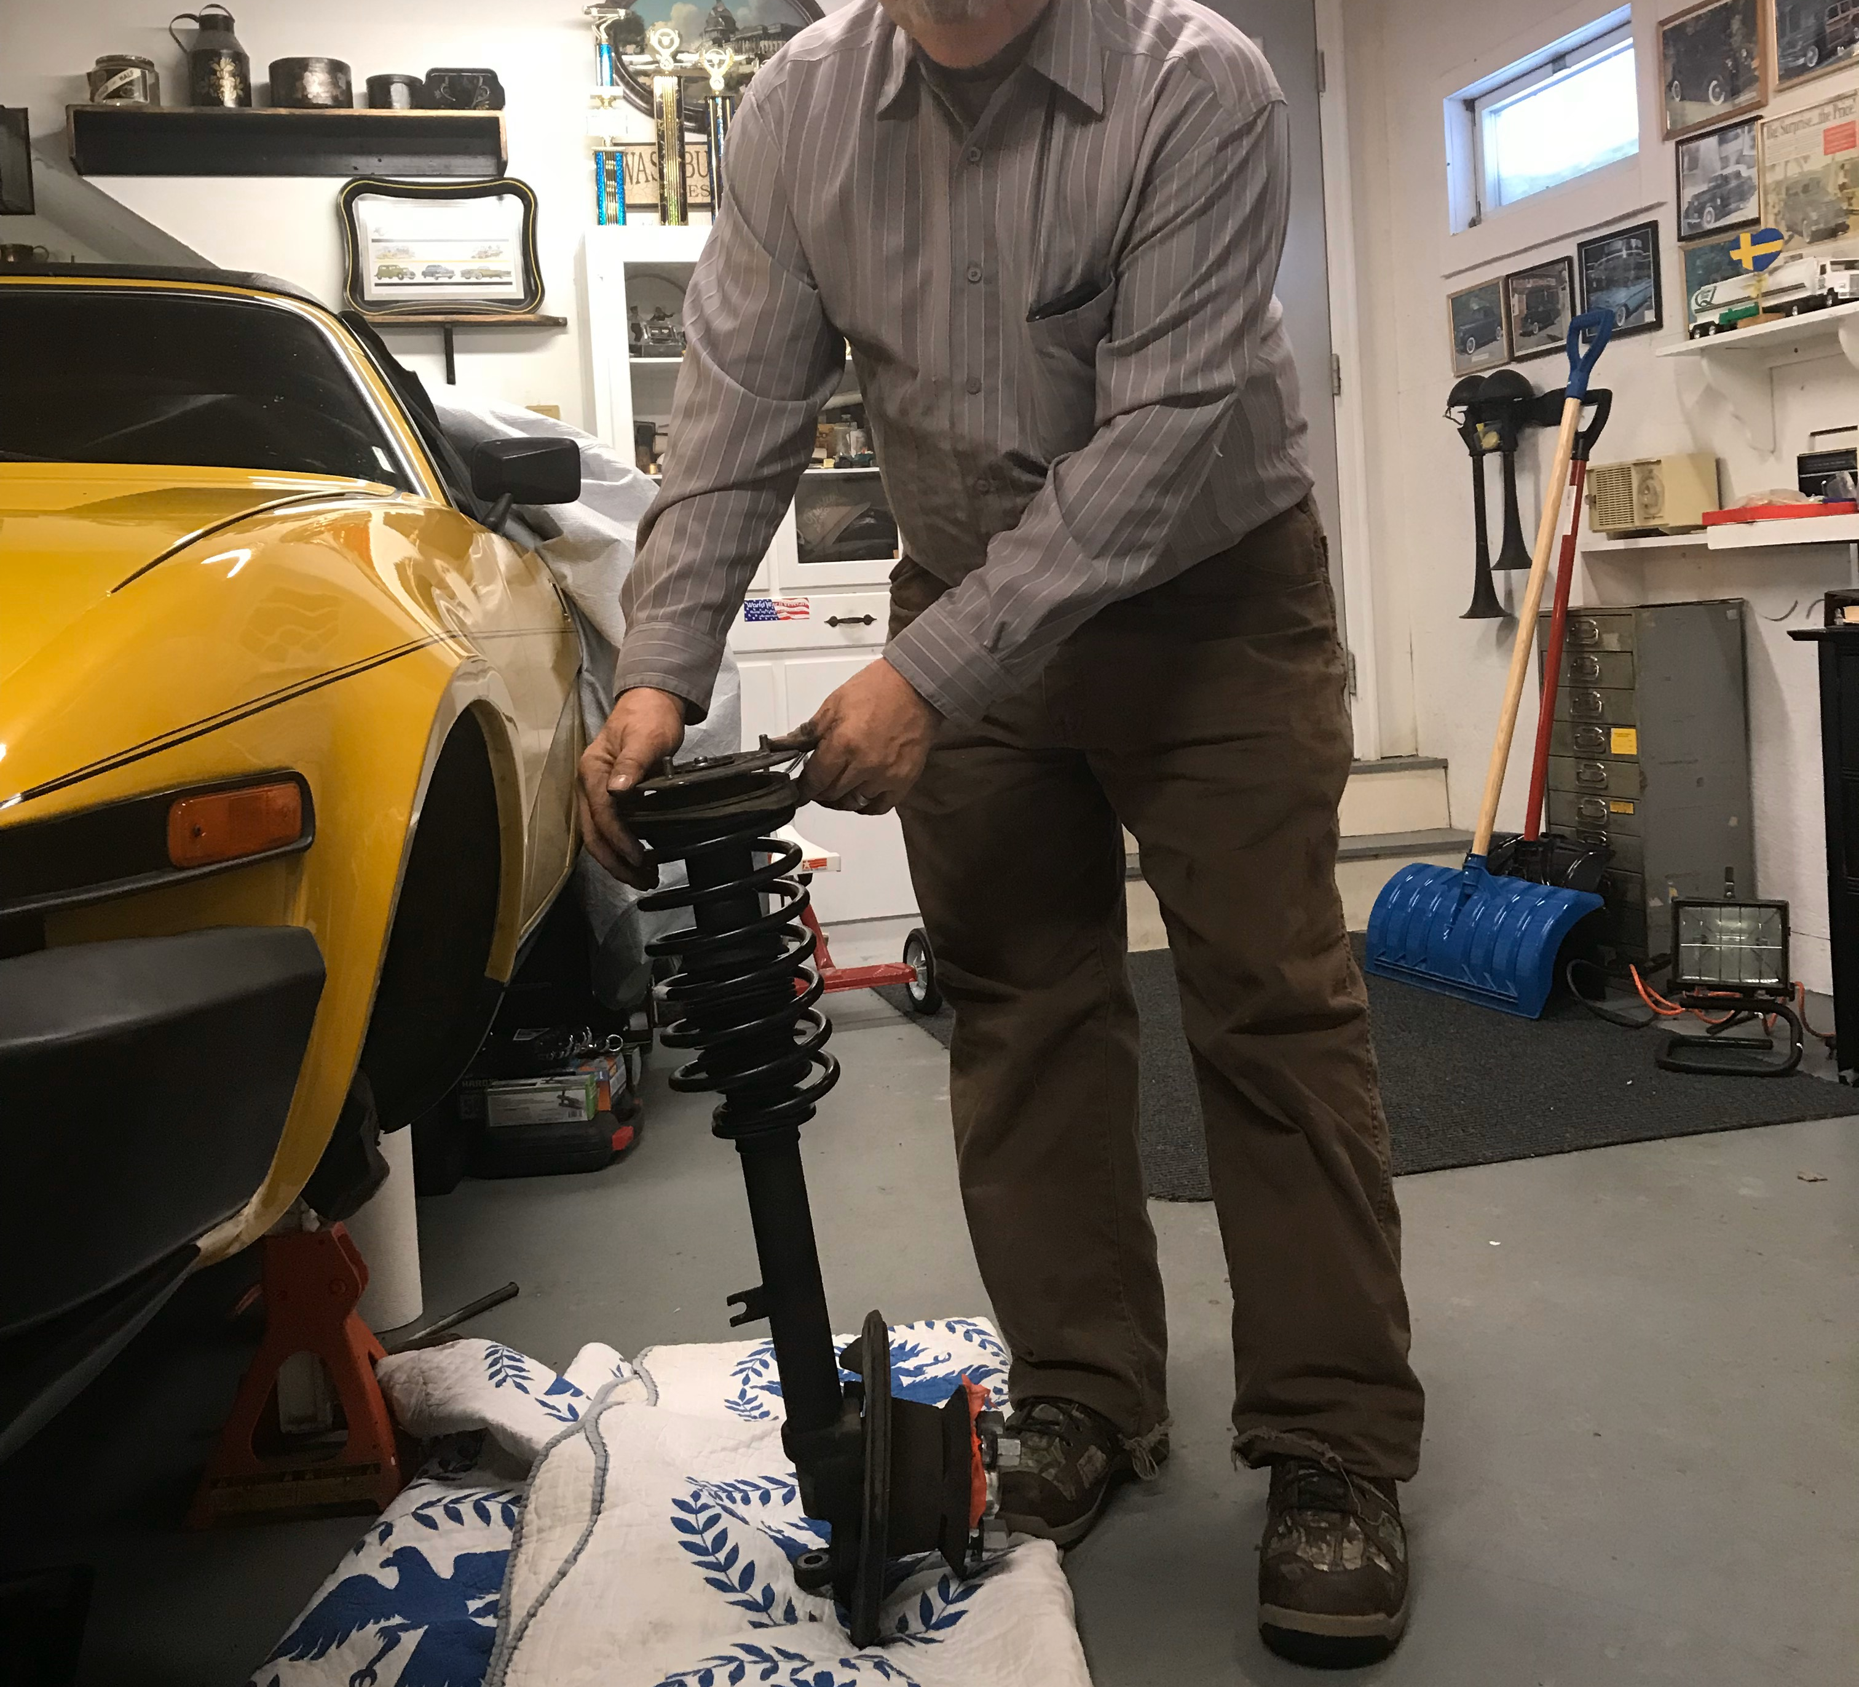
ALMOST
DONE !

Slide 44
Step 5: Complete Your Post Application Summary
Must be completed within 30 days of completion of the application
Its purpose differs from the Fumigation Management Plan
It documents deviations from the Fumigation Management Plan
It describes measures taken to comply with GAPs, if not noted in the FMP
It documents incidents/complaints by abutters
Very important ! Don’t skimp on detail. CYA-5 minutes of writing now could save you 5 days of non-productive work later
Maintain the Post Application Summary along with the Fumigation Management Plan for 2 years.

Slide 45
Remember that how well you drive this process will have an impact on your counterparts. A problem created by one party may have an impact on all of us.

Slide 46
Case in Point:
2003 Soil Fumigant application in Kern Cty, California
80 lb/fumigant applied to 34 acres
18 acres first day
16 acres second day
Each night following applications residents ¼ mile away from the application site reported symptons similar to fumigant exposure-165 persons total.
Incident resulted in new regulations for that particular fumigant
No applications within ¼ of an occupied structure
Use of this fumigant can only be accomplished with application of heavy tarps

Slide 47
CONCLUSION !
Document the pests you are targeting
Become properly certified and train all handlers accordingly
Prepare a Site-Specific Fumigation Management Plan worthy of your operation
Maintain your Pesticide Applicator Log with fumigation applications
Prepare a post application summary
Don’t guess on compliance- Call us !

Slide 48
QUESTIONS/COMMENTS ? (207)592-0416 keith.r.brown@maine.gov
Thank you
and
BE SAFE !

